Slide 1

Noida Institute of Engineering and Technology, Greater Noida
Waste Management Purpose And Strategies
Unit: 3
Sustainable Technologies
AOE0866
ANAMIKA SRIVASTAVA
Assistant Professor
CSE,CSER & M.Tech Integ.
CSE 8TH SEM

Slide 2
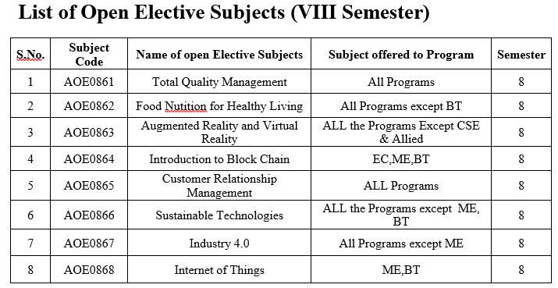
Evaluation Scheme

Slide 3
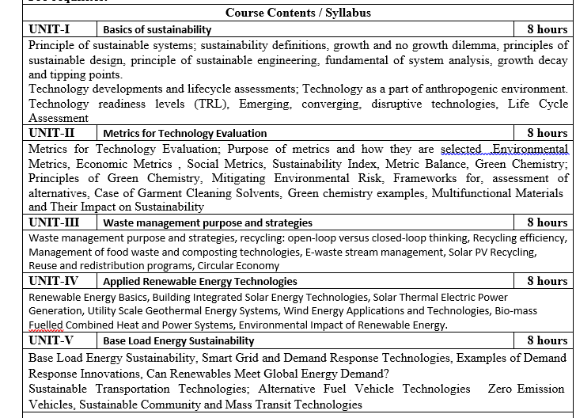
Syllabus

Slide 4
CO with blooms taxonomy
CO 1: Understand the principles of sustainable systems and demonstrate how the economic and technical performance of sustainable technologies can be measured and compared. K2 (Understand)
CO 2: Identify the technical and economic obstacles to the widespread use of sustainable technologies. K3 (Apply)
CO 3: Assess sustainable technologies to show the greatest long-term promise in terms of social, environmental, and economic metrics. K3 (Apply)
CO 4: Identify types of sustainable energy technologies that are closest to commercialization. K2 (Understand)

Slide 5
Branch wise Application
First, we will start with the internet which is very much important for our daily life and we cannot even imagine our life without the internet and it is the outcome of clever and creative algorithms. Numerous sites on the internet can operate and falsify this huge number of data only with the help of these algorithms.
The everyday electronic commerce activities are massively subject to our data, for example, credit or debit card numbers, passwords, OTPs, and many more. The centre technologies used incorporate public-key cryptocurrency and digital signatures which depend on mathematical algorithms.
Even an application that doesn't need algorithm content at the application level depends vigorously on the algorithm as the application relies upon hardware, GUI, networking, or object direction and all of these create a substantial use of algorithms.
There are some other vital use cases where the algorithm has been used such as if we watch any video on YouTube then next time we will get related-type advice as recommended videos for us.

Slide 6
Program Outcome
At the end of the semester, the student will be able:
POs | Engineering Graduates will be able to
PO1 | Engineering Knowledge
PO2 | Problem Analysis
PO3 | Design & Development of solutions
PO4 | Conduct Investigation of complex problems
PO5 | Modern Tool Usage
PO6 | The Engineer and Society
PO7 | Environment and sustainability
PO8 | Ethics
PO9 | Individual & Team work
PO10 | Communication
PO11 | Project management and Finance
PO12 | Life Long Learning

Slide 7
CO-PO and PSO Mapping
Design and Analysis of Algorithm (kCS-502)
CO.K | PO1 | PO2 | PO3 | PO4 | PO5 | PO6 | PO7 | PO8 | PO9 | PO10 | PO11 | PO12
ACSE0401.1 | 3 | 3 | 3 | 3 | 2 | - | - | - | 2 | 2 | - | 3
ACSE0401.2 | 3 | 3 | 3 | 3 | 2 | 2 | - | 1 | 1 | 1 | - | 3
ACSE0401.3 | 3 | 3 | 2 | 3 | 3 | 2 | - | 2 | 1 | 1 | 2 | 3
ACSE0401.4 | 3 | 3 | 3 | 3 | 2 | 2 | - | 2 | 2 | 1 | 3 | 3
ACSE0401.5 | 2 | 2 | 2 | 2 | 2 | 2 | - | 2 | 1 | 1 | 1 | 2
Average | 2.8 | 2.8 | 2.6 | 2.8 | 2.2 | 1.6 | - | 1.8 | 1.4 | 1.2 | 1.2 | 2.8

Slide 8
Program Educational Objectives(PEOs)
PEO1: To have an excellent scientific and engineering breadth so as to
comprehend, analyze, design and provide sustainable solutions for
real-life problems using state-of-the-art technologies.
PEO2:To have a successful career in industries, to pursue higher studies or
to support enterpreneurial endeavors and to face global challenges.
PEO3:To have an effective communication skills, professional attitude,
ethical values and a desire to learn specific knowledge in emerging
trends, technologies for research, innovation and product
development and contribution to society.
PEO4: To have life-long learning for up-skilling and re-skilling for
successful professional career as engineer, scientist, enterpreneur
and bureaucrat for betterment of society

Slide 9
End Semester Question Paper Template
B TECH
(SEM-V) THEORY EXAMINATION 20__-20__
DESIGN AND ANALYSIS OF ALGORITHMS
Time: 3 Hours Total Marks: 100
Note: 1. Attempt all Sections. If require any missing data; then choose suitably.
SECTION A
Attempt all questions in brief. 2 x 10 = 20
Q.No. | Question | Marks | CO
1 |  | 2
2 |  | 2
. |  | .
10 |  | 2

Slide 10
End Semester Question Paper Templates
SECTION B
2. Attempt any three of the following: 3 x 10 = 30
SECTION C
3. Attempt any one part of the following: 1 x 10 = 10
Q.No. | Question | Marks | CO
1 |  | 10
2 |  | 10
. |  | .
5 |  | 10
Q.No. | Question | Marks | CO
1 |  | 10
2 |  | 10

Slide 11
End Semester Question Paper Templates
4. Attempt any one part of the following: 1 x 10 = 10
5. Attempt any one part of the following: 1 x 10 = 10
6. Attempt any one part of the following: 1 x 10 = 10
Q.No. | Question | Marks | CO
1 |  | 10
2 |  | 10
Q.No. | Question | Marks | CO
1 |  | 10
2 |  | 10
Q.No. | Question | Marks | CO
1 |  | 10
2 |  | 10

Slide 12
Unit Objective
Sustainable waste management aims to keep materials in use for as long as possible and minimize the amount of solid waste that is disposed of in landfill or through incineration. However, in our existing linear economy, waste begins even before products are manufactured, and a more in-depth approach to sustainable waste management must focus on the entire lifecycle of a product to enable us to help reduce the negative environmental, social, and financial impacts of 21st-century consumption.
The question then, of what exactly is sustainable waste management, is important if we are to refine and improve our existing waste management systems. Whether focusing on waste reduction at end-of-life or designing waste out of the production cycle at the conceptual stage, new waste management practices are required to effectively deal with existing waste streams while also reducing the amount of waste at the same time.
.

Slide 13
Waste Management Purpose And Strategies
Sustainable waste management is a central part of a broader circular economy. It’s a systemic approach to economic development that stands in opposition to the take-make-waste model and aims to separate growth from the consumption of finite resources. Sustainable waste management helps tackle the broader issues of a linear consumption society, but also offers more direct solutions to the many problems waste causes.
Failing to follow the sustainable waste management hierarchy means that otherwise usable goods and materials are sent to landfill or incinerators as part of energy recovery programs.

Slide 14
Waste Management Purpose And Strategies
Paper and paperboard
According to the EPA, the single largest component of municipal solid waste (MSW) in the United States is paper and paperboard products, which while usually biodegradable and less damaging than plastics, still place undue stress on our environment through wasteful consumption.
The use of raw materials within the manufacturing of new products in paper and card causes deforestation, as well as using massive amounts of energy and water. Additionally, while this particular waste stream has very high recycling rates, 100 million tons of wood could be saved each year if all wasted paper was processed through effective recycling programs, with just one ton saving “17 trees, 2 barrels of oil (enough to run the average car for 1,260 miles), 4,100 kilowatts of energy (enough power for the average home for 6 months), 3.2 cubic yards of landfill space, and 60 pounds of pollution.”

Slide 15
Waste Management Purpose And Strategies
Food waste
Food waste is the second single largest component of municipal solid waste, at 21.59% according to the EPA, and has major social, financial, and environmental impacts. In the US, the amount of food wasted amounts to roughly $161 billion a year, or nearly 40% of the total US food supply. To compound the issue, around 10% of all US households suffered some level of food insecurity in 2019, and much of the food that ends up wasted is perfectly edible. Sustainable waste management could actually keep “waste materials” in the loop through donation or composting, but instead our existing systems send it to landfill where it breaks down and releases CO2 and methane, both of which contribute heavily to global warming.

Slide 16
Waste Management Purpose And Strategies
Plastic
The third-largest component of MSW is plastics, which have become the poster child of the dangers of a linear economy, with single-use products choking land and ocean. From the petrochemicals that must be extracted to produce new material to the estimated $2.5 trillion in damage and lost resources, plastic waste is a problem. Sustainable waste management means reducing and avoiding the amount of single-use plastic products along with increasing the amount recycled at the same time, which currently stands at just 8.5%.

Slide 17
Waste Management Purpose And Strategies
Placing waste on the hierarchy
Sustainable waste management relies on the waste management hierarchy, a system that focuses on avoidance, reduction, reuse, recycling, energy recovery, and finally, treatment or disposal. It aims to prioritize actions for the most efficient use of resources, placing renewable and less wasteful practices at the top of the pyramid. Here, we look at how the waste management hierarchy is central to sustainable waste management.

Slide 18
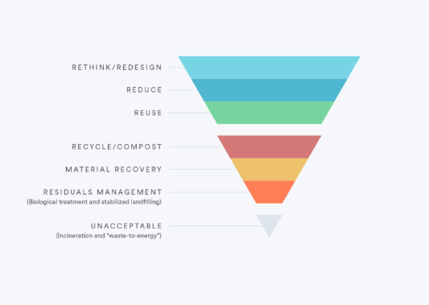
Waste Management Purpose And Strategies

Slide 19
Waste Management Purpose And Strategies
Avoidance and reduction
Avoiding and reducing the amount of waste generated is the first priority. This can be achieved by maximizing efficiency and reducing consumption. First, businesses and individuals should choose products that require the fewest resources to produce (including the packaging). Additionally, single-use or disposable goods should be avoided wherever possible— these materials are the embodiment of linear waste in which resources are extracted, processed, and distributed only to quickly become waste.

Slide 20
Waste Management Purpose And Strategies
Reuse and recycling
If the consumption of a product can’t be avoided, then there should be a focus on purchasing products that can be reused or repaired, as well as education around how to reuse waste products. Reusing is preferred to options lower down the hierarchy since it can be done without processing new materials, which takes money, energy, and often other resources. Reuse, which is also one of the central tenets of the zero-waste philosophy, can come in the form of having shoes repaired, donating clothes and items for others to use and even researching recipes for food leftovers rather than throwing them in the trash.

Slide 21
Waste Management Purpose And Strategies
Energy recovery
The next step is energy recovery, which is the conversion of waste into usable heat, electricity, or fuel such as biogas. This is achieved through a variety of processes such as incineration (with energy collection), gasification, pyrolization, anaerobic digestion, and landfill gas (LFG) recovery, which has some crossover with the last step of waste management.

Slide 22
Waste Management Purpose And Strategies
Treatment or disposal
The last and least desirable step in the hierarchy is treatment or disposal. This generally means landfills or incineration without energy recovery. This will inevitably happen to some waste but should be avoided for as long as possible through sustainable waste management.

Slide 23
Ways to start making your waste management more sustainable
There are some simple ways to start implementing sustainable waste management in homes and businesses, and here a few tips to help you figure out how and where waste is being generated and take steps to tackle it.

Slide 24
Ways to start making your waste management more sustainable
Scrap single-use items
Replace single-use items with reusable ones. Instead of cardboard coffee cups, get mugs or glasses. It’s also important to note at this point that even at commercial composting plants, many seemingly green items — such as compostable coffee cups — can’t actually be composted, and instead break down in landfill. Switching to a greener alternative could save the planet as well as money.

Slide 25
Ways to start making your waste management more sustainable
Switch to digital
As mentioned earlier, paper and paper products make up the single largest part of MSW. For businesses, a relatively easy way to improve sustainable waste management is by switching as much paperwork as possible to digital versions. This could be issuing/receiving invoices online rather than physically, having meeting minutes in a shared document rather than printed, or switching to online banking.

Slide 26
Ways to start making your waste management more sustainable
Offer a trash alternative
It is likely that many types of waste will be generated in a business, and one way to drive more sustainable waste management is providing the means for all employees to take action. This can be as simple as providing recycling and compost bins alongside regular trash and having services to properly manage this waste.

Slide 27
Ways to start making your waste management more sustainable
Can someone else use it?
Reuse is better than recycling, so considering whether a business can donate any materials that would otherwise go to waste is a great way to improve sustainability. This could be overstocked foods in stores and restaurants, old hardware from offices, out-of-promotion goods from non-food stores, or even materials from renovations.
Waste management can be sustainable in both businesses and homes if the right framework is implemented. But more importantly, the consequences, if waste is left unchecked, are too great not to consider.

Slide 28
Open loop vs closed loop thinking
As we can see from the previous page of this lesson, there are a number of conventional methods of waste treatment which depend on the system scale and type of waste. However, not all of them fit in the sustainability picture. For example, such common methods as incineration or landfilling are not sustainable solutions because, while eliminating problem in one zone (for example, human residence or industrial facility), they create additional pollution in the other (atmosphere, soil, aquifers, natural habitat). The purpose of recycling is to minimize or completely avoid sending waste to landfill or incinerator.
There are two major stages in recycling strategy: collection and processing. Both may consume resources and limit the process efficiency. The main recyclables are metals, plastics, glass, paper, and wood. Those materials are common in consumer products, so the public needs to be involved in the process. Public acceptance is important for the success of recollection of those recyclable materials (for example, public awareness and availability of collection points in public places plays a role – see image above). At the stage of processing, the question of recyclability is often related to the product design. How difficult and expensive is it to retrieve those materials from the product? You need to get those materials separated in a pure form in order to make them reusable in the same or new products.

Slide 29
Open loop vs closed loop thinking
To refute those commonplace skeptical arguments, the Environmental Protection Agency (EPA) provides some clear evidence on the benefits of recycling to the planet. Here are just a few facts:
Recycling aluminum cans saves 95% of the energy needed to make new cans from raw aluminum ore;
Recycling steel cans saves around 60% of energy;
Recycling paper saves on the average 60% of energy
Recycling plastic saves about 75% of energy;
Recycling glass saves about 20-35% of the energy compared to making those products from virgin materials. In fact, the energy saved by recycling one glass bottle will operate a 100 watt light bulb for four hours
Recycling helps reduce litter, thus mitigating the spread of bacterial or fungal infections.
Among the social benefits is creation of jobs: ~1.25 million in the United States alone.

Slide 30
Open loop vs closed loop thinking
Open-loop Recycling
Open-loop recycling basically means that a material is not recycled indefinitely and is eventually excluded from the utilization loop and becomes waste. The diagram in Figure 5.1. shows a material flow through the linear (open-loop) system. In this representation, stocks are shown with rectangular boxes, and transforming processes are shown by hexagon boxes.
In Figure 5.1. below, we see that natural resources extracted from the environment are transformed into a product via manufacturing process. After its use, the product may be discarded as one of the outputs: (a) whole product that is not needed anymore, (b) whole product that became obsolete (although still functional), (c) non-functional or old product because of its limited lifetime, (d) recyclable / reusable parts or scrapped materials, and (e) non-recyclable refuse. Those outputs enter one of the post-use channels – reuse, recycle, and garbage disposal, the latter contributing to the landfill. Reuse channel is usually limited, just postponing garbage disposal. Recycling loop results in producing another material, which is typically of lower grade and purity than the original material. It may be transformed further into a different product, which after use creates similar outputs. In the long run, a small part of the original resource may be stuck in the loop, but the majority of it becomes disposed of.

Slide 31
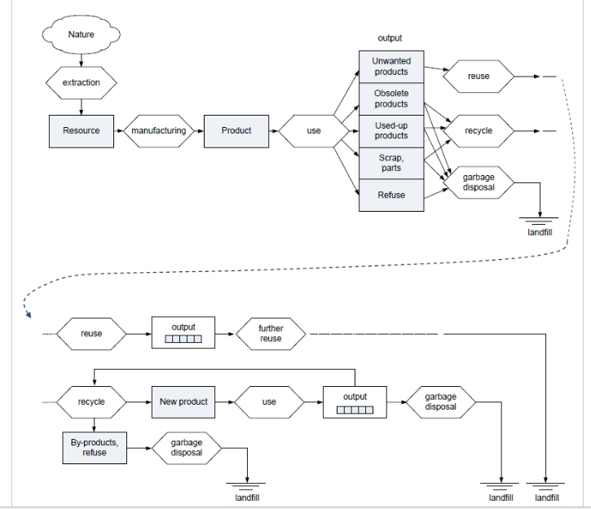
Open loop vs closed loop thinking

Slide 32
Open loop vs closed loop thinking
The bottom line is: even if recycling and reuse are involved, eventual down-grading renders material non-usable, and it contributes to waste generation in the end of the lifecycle. Open-loop recycling postpones disposal and slows down extraction of new natural resources, but does not provide an ultimate solution to the problem.

Slide 33
Open loop vs closed loop thinking
Closed-loop Recycling
Closed-loop recycling is a more sustainable concept, which means that recycling of a material can be done indefinitely without degradation of properties. In this case, conversion of the used product back to raw material allows repeated making of the same product over and over again.
A few things to consider:
The recycled materials should provide the same quality of the product (no deterioration). For example, almost all recycled aluminum from soda cans is suitable to produce the same cans.
There should be no accumulation of contaminants or toxins in the multiple recycling loop, which can make the secondary product less safe.
The recycled material can also feed a manufacturing process for a different product or industry, which may require a different type of recycling.
The other part of closed-loop recycling concept is biodegradable disposal. Everything that cannot be recycled or comes as a by-product in the manufacturing process should return to the environment with no harm. The diagram in Figure 5.2 summarizes the above considerations. While starting from the same extraction, manufacturing, and use stages, the outputs in the closed-loop scheme become equally usable resource for the manufacturing chain. Greater fraction of materials should be designed for recycling and reuse. The refuse that is inevitable is biodegradable and brings no harm when returned to the environment.

Slide 34
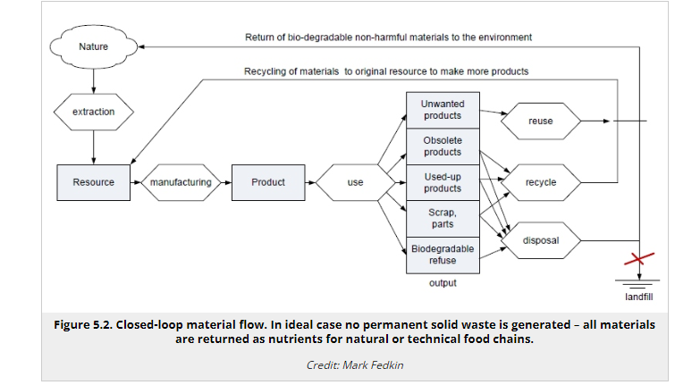
Open loop vs closed loop thinking

Slide 35
Open loop vs closed loop thinking
In any sustainability scenario, closed-loop approach is the goal. But it would take radical changes and innovative thinking at the level of product and process design.
To a greater extent, this closed loop thinking is advocated in the book of William McDonough and Michael Braungart “Cradle-to-Cradle”. The authors suggest that every product and all packaging should have a complete closed-loop cycle mapped out for each component, i.e., pathways should be identified for each component to either be recycled indefinitely or to return to the natural ecosystem.

Slide 36
Recycling Efficiency
We understand that recycling materials from the waste stream helps to conserve resources. But the question often arises: How much material can be actually recovered, and is it worth spending energy and labor for it, or it is easier to extract fresh material from the environment? A useful metric to characterize technical performance of a recycling line is recycling efficiency. The general approach to estimate efficiency is as follows:
Determine the input of the process: Input is measured as the mass or volume of all fractions or materials entering the recycling process per time period (usually per year) - m_{i}(in)
Determine the output of the process: Output includes the mass of the useful recycled components - m_{i}(out), excluding any unrecycled material sent to refuse. Loss of the components to the refuse can be due to process inefficiencies, such as sorting losses, damages or loss of quality, loss of slag and emissions, accidental presence of non-recyclable items.

Slide 37
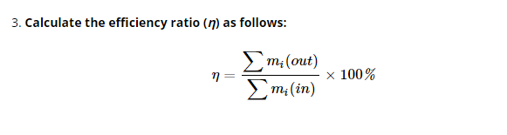
Recycling Efficiency

Slide 38
Recycling Efficiency
Example
Consider the case of recycling Pb-acid batteries. Input will include lead metal (Pb) together with liquids and other solids contained in a battery and also the external jacket. Let us count recovered Pb as useful output, but any chemicals that cannot be salvaged and must be disposed off are not included. Then efficiency of lead recovery can be estimated as: η = m_{Pb}(out) / m_{i}(in) x 100%
Let us imagine that a small recycling facility treats 13,000 kg of old batteries per year. If the amount of the recovered lead is for example 7,000 kg per year, then η = 7,000 / 13,000 × 100% = 54%
That means that the other 46% of material supplied to the recycling process is lost or discarded (e.g., non-recyclable acid and other chemicals, slag, etc.). Note, the above numbers are randomly picked and used merely for example.
100% efficiency is possible only in the ideal case when no waste is sent to the landfill or incineration.

Slide 39
Management Of Food Waste And Composting Technologies
Food waste accounts for 14.5% of all generated waste in the US according to EPA report, and only a small portion of it is recovered (1.6%). At the same time, food waste contains loads of nutrients that can be returned to the environment, but it should be done the right way. Disposing of the organic waste in the landfill results in the generation of methane, which can pose a threat or contribute to the greenhouse effect. Hence, developing composting technologies is an important part of a sustainable waste management system.
Compost is a stable organic mixture resulting from the breakdown of organic components; it is typically dark brown or black and contains humus which provides a soil-like, earthy smell. Compost is widely used as fertilizer and soil amendment in agriculture. It is created by piling organic wastes (garden waste, leaves, food waste, manure) with bulking agents (e.g., wood chips) to provide an environment for anaerobic bacteria and fungi to manage the chemical decomposition process. Compost is stabilized through maturation and curing process.

Slide 40
Management Of Food Waste And Composting Technologies
According to US EPA, there are a number of benefits of the composting process. These include:
reduction and elimination of the need for chemical fertilizers;
increasing of crop yields;
facilitation of reforestation, wetland restoration, and habitat revitalization by amending contaminated, compacted, and marginal soils;
cost-effective remediation of soils contaminated by hazardous waste;
absorption and removal of solids, oil, grease, and heavy metals from stormwater runoff;
avoidance of methane and leachate formation in landfills;
decreased need for water, fertilizers, and pesticides in agriculture;
serving as a marketable commodity and as a low-cost alternative to standard landfill cover;
capturing and destruction of 99.6 percent of industrial volatile organic chemicals (VOCs) in contaminated air;
more cost-effective soil, water, and air remediation compared to conventional technologies;
extension of municipal landfill life by diverting organic materials from landfills.
Certain physical conditions need to be provided for proper composting process. There are different types of processes, which are overviewed in the following reading.

Slide 41
Management Of Food Waste And Composting Technologies
While having obvious benefits, composting is far from being environmentally clean. When organic components are mixed and concentrated during waste collection, they create aggressive gases and liquid effluents, which should be carefully controlled. In the diagram in Figure 5.3. The side inputs and outputs accompanying the composting process are shown. The pre-composting weighing and pre-processing stages generate liquid leachate, gas exhausts, and solid residue as by-products. The composting stage requires input of air and water, while generating more potentially polluting exhaust and effluents. Some of the residue is reusable, but some is not and need to be disposed of as non-recyclable waste.

Slide 42
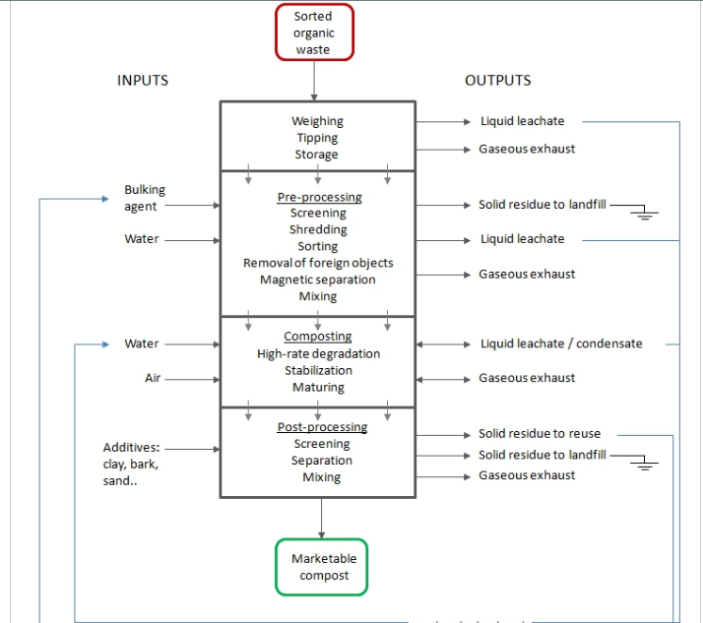
Management Of Food Waste And Composting Technologies

Slide 43
E-waste Stream Management
There are reasons to separate the electronics waste stream:
rapid growth of the electronic manufacturing volume, market, and rapid change in technology resulting in new products
complexity of electronic products, which requires special approach in recycling
use of rare and precious metals and compounds, many of which should be recovered
presence of toxic chemicals and other substances of environmental concern
opportunities of efficient material and component reuse
Electronics recycling, computers for instance, is essentially a process of breaking down the final product back to components (some of which can be reused) and initial raw materials (such as copper, gold, silver, other metals, plastics). Because of significant load of technological product with heavy metals and toxic compounds (e.g., mercury, cadmium, lead, flame retardants), discarded electronics are classified as hazardous waste. Hence, recycling also requires strict measures of environmental safety.

Slide 44
E-waste Stream Management
However, currently existing programs of sorting / disassembly are hardly sufficient. The problem is that current computer and other electronic products are not designed to be recycled. End-of-life disassembly and recovery of pure materials is a tedious and expensive process. Few companies manage to build an effective infrastructure for electronic recycling. Even if responsible recycling practices exist, they hardly keep up with growing market for electronics and accelerating e-waste accumulation pace.
Unfortunately, there are businesses that find it more profitable to export the electronic waste overseas to developing countries. This practice, highly non-sustainable on the global scale and harmful to local population and environment, is an ugly illustration of shifting the environmental burden from one part of the global system to another:
For example, this video contains graphic illustrations of such irresponsible “recycling”.

Slide 45
E-waste Stream Management
So, what are possible sustainable solutions to address the root of the e-waste problem?
Design devices with environmentally benign components and chemicals.
Design computers and other fast-rotating systems easily recyclable (to cut cost and increase process efficiency).

Slide 46
Solar PV Recycling
The average lifespan of a solar panel being approximately 20 years, many installations from the early 2000s are set to reach end-of-life. So, it's about time for them to be recycled but the real question is will they be recycled? With the presence of heavy metals waste cannot be managed poorly. It is also a known fact that the value of the recovered materials after recycling is nothing compared to the original materials.
There is potential in the field of PV recycling. In a typical crystalline solar module, there are components like glass, polymer, solar cells themselves, Copper, Aluminum, and trace amounts of other metals. The largest contributor of the total weight is glass which is 75% followed by a polymer which is 10% and Aluminum which is 8%. Trace amounts include Silver, Lead, and Tin is present.

Slide 47
Solar PV Recycling
A second life for the panels
Solar companies try to reuse the materials from solar panels. It is considered to be the simplest and cheapest way to recycle and requires the least processing. For example, a used solar panel will cost sound half the price of its initial cost, and the components used in it might even be sold for less than half the price of used panels. Panels only make up, at most, about half the cost of a residential solar array, with the other equipment and permits accounting for the rest. Given that used panels don’t generate as much electricity, the money saved by buying them might not be worth it. Used panels that can be resold are usually dumped into landfills. In the US many states are pushing for mandatory recycling for PV module manufacturers. The European Union, meanwhile, requires manufacturers to collect and recycle used solar panels and fund research on end-of-life solutions for the technology they produce.

Slide 48
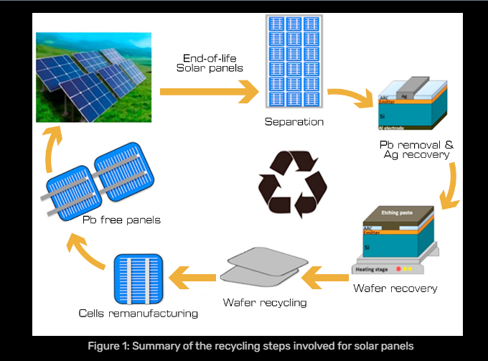
Solar PV Recycling

Slide 49
Solar PV Recycling
Methods of Recycling
There are three main stages of PV recycling; (1) delamination, (2) material separation, and (3) material extraction and purification. Solar panels are largely recycled mainly by chemical, thermal and mechanical processes. The process starts with the removal of the junction box, wires, and frame. Then, the module is shredded, sorted, and separated. The separation of the materials allows them to be sent to specific recycling processes associated with each material. The process mentioned above is for crystalline silicon panels. a summary of the process can be seen in the figure below.

Slide 50
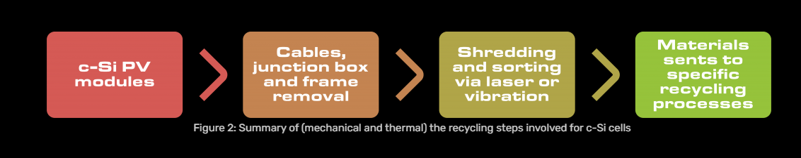
Solar PV Recycling

Slide 51
Solar PV Recycling
CdTe (Cadmium Telluride) solar cells are second-generation solar cells that are recycled a bit differently when compared to c-Si (crystalline silicon) solar cells. The process usually starts with the shredding of pieces into larger a then into smaller fragments. Then the semiconductor metals are slowly removed. Sodium hydroxide is used to precipitate the metal compounds, and the glass is separated so that it can be reused again.
Another method for Cadmium Telluride solar panels recycling includes physical fragmentation of small modules. After that, these small pieces are exposed to an atmosphere containing oxygen at 300°C. These conditions result in the delamination of the EVA. Subsequently, these fragments are taken to a 400°C atmosphere containing chlorine gas which causes an etching process. This step of the process generates CdCl₂(Cadmium Chloride) and TeCl­₄ (Tellurium Tetrachloride) that are condensed and precipitated afterward.

Slide 52
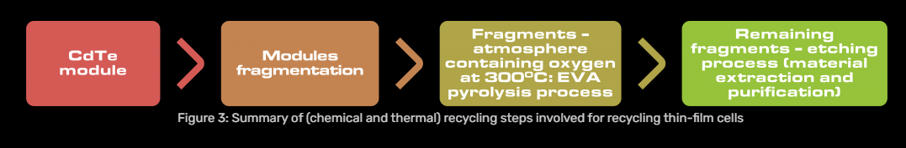
Solar PV Recycling

Slide 53
Solar PV Recycling
The methods described are few among the many. There are still methods that are being researched. The main issue or concern during the recycling process is the issue of impurity levels. For example, high-temperature thermal processes and mechanical processes can create impurities. Also, low-temperature processes that are used with specific mechanical or chemical steps can generate impurities as well. Hence, the ideal outcome can only be achieved with a combination of thermal, chemical, or metallurgical steps. Once these materials can be recovered without the impurities, they will have a higher value in the market which is one of the main obstacles related to the PV recycling industry.

Slide 54
Solar PV Recycling
Environmental impacts
A study was done on the environmental impacts of recycling crystalline silicon (c-SI) and cadmium telluride (CDTE) solar panels by (Thomas et al., 2020) shows that the recycling phase of c -Si PVs will contribute 15 -35 % more impacts to cradle -to -gate environmental impacts of c -Si PVs which implies the impact of recycling on the entire life cycle impacts of c -Si PVs varies 15 -25 % depending on chosen recycling technique.
For CdTe panels, the contribution of the recycling phase on the entire life cycle is minor 3 -4 % depending on chosen recycling method. Less electricity consumption results in fewer impacts. In comparison c -Si produced significantly higher impacts than CdTe. This is mainly because c -Si material separation utilizes more mass of chemicals than CdTe. The recycling of c -Si PV panels should primarily be planned to recover Ag(silver) metal.
In this way, more environmental impacts can be avoided, and the cost of remanufacturing can be reduced significantly. As for Cadmium Telluride panels, Glass is the most impactful element because it occupies about 94% of the CdTe panel and cadmium and tellurium are more expensive as they are rare earth metals. So, recycling methods should be focused on recovering these materials primarily in an environmentally friendly way. Reuse, repair, remanufacturing, and repurposing are expected to play key roles in the future to develop a circular economy model based on PV waste manufacturing.

Slide 55
Reuse And Redistribution Programs
Reuse is the second level of the national solid waste management hierarchy. Reuse is simply repeated using a product or component in its original form. For example, using a glass milk bottle multiple times within the producer – customer chain (instead of using a plastic bottle).
Reuse also means that materials and products are redistributed from one who no longer needs them to those who can still find use in the items. The benefit of reuse is not only in conservation of valuable natural resources, but also in getting materials and products to disadvantaged people and organizations.

Slide 56
Reuse And Redistribution Programs
Here are a few examples of successful material reuse programs, which attempt to divert the flow of useful resources from the waste stream:
"LIFT" reuse program(link is external) accepts gently used equipment designed for persons with disabilities and redistributes it to people in need. They perform safety checks and sanitation of the donated items. The program accepts walkers, wheelchairs, transfer chairs, raised toilet seats, shower chairs, adapted telephones, low-vision aids, reachers, and any other equipment that helps with independence.
"Soles 4 Souls(link is external)" nation-wide program that has a mission "fighting the devastating impact and perpetuation of poverty through the distribution of shoes and clothing... Most new items collected primarily from corporations and retailers are given directly to people in need, both in the U.S. and overseas. The organization has relationships with several of the world’s leading apparel brands, which provides Soles4Souls with new but non-marketable overstocks, returns, discontinued models and other shoes or clothing items."

Slide 57
Reuse And Redistribution Programs
Cooling pack reuse program(link is external): Employees of a medical facility initiated a program to divert reusable cooling packs from trash. Cooling packs are very common supplies that are used to keep the medical samples cooled for transportation. They were normally discarded once samples arrive at the facility, which has a stationary refrigeration system. The program established a few routes to reuse the packs while helping local food banks.

Slide 58
Circular Economy
The role of circular economy in sustainable business and innovation is immense. The circular economy is an economic model that aims to eliminate waste and promote sustainable resource use by closing the loop of production, consumption, and disposal.
It is a departure from the traditional linear economy, which follows a “take-make-dispose” approach, leading to resource depletion and environmental degradation.
In contrast, the sustainable circular economy seeks to design out waste and pollution, keep products and materials in use for as long as possible, and regenerate natural systems.
The circular economy is founded on a set of key principles that drive sustainable production, responsible consumption, efficient waste management, and the overall well-being of individuals. These principles form the core foundation of the circular economy approach, guiding its implementation and impact.

Slide 59
Circular Economy
Designing out Waste and Pollution
In a sustainable circular economy, the principle of designing out waste and pollution involves integrating sustainable practices throughout the entire product lifecycle. This includes:
Utilizing eco-design techniques,
Optimizing manufacturing processes for resource efficiency,
Prioritizing the use of non-toxic materials.
By adopting these measures, products are designed to minimise waste generation and environmental harm, ensuring a more sustainable and circular approach to production and consumption.
This principle promotes a closed-loop system where resources are continually utilised and waste is minimised.

Slide 60
Circular Economy
Keeping Products and Materials in Use
The circular economy emphasises prolonging the lifespan of products and materials through reuse, repair, refurbishment, and remanufacturing.
By extending product life cycles and encouraging sharing, leasing, and product-as-a-service models, valuable resources are preserved, and waste generation is minimised.

Slide 61
Circular Economy
Regenerating Natural Systems
In a sustainable circular economy, the principle of regenerating natural systems focuses on restoring and replenishing the resources and ecosystems we rely on. We can sustain our planet by supporting renewable energy, regenerative agriculture, reforestation, and ecosystem restoration.
This strategy promotes harmony between humans and the environment, creating a resilient and balanced ecosystem for future generations.

Slide 62
Benefits of the Circular Economy
A circular economy involves reusing resources and materials rather than discarding them, creating a circular flow of consumption. However, its implementation requires significant systemic change, which poses a challenge for many.
Nevertheless, the EU’s adoption of a plan in 2020 to achieve a circular economy demonstrates its feasibility and commitment. This exemplifies that individual, business, and government efforts can drive the transition towards a circular economy.
While achieving this goal may seem daunting, it is important not to abandon the idea, as concrete actions are being taken to make it a reality and contribute to the 2050 climate neutrality target.
The feasibility of a circular economy and the ongoing efforts to implement it highlight the potential for significant benefits that justify the extensive systemic changes required for its adoption.
The Circular Economy offers several benefits that contribute to a more sustainable and resource-efficient society. Here are some of the key advantages:

Slide 63
Benefits of the Circular Economy
1. Resource Conservation
In a sustainable circular economy, resources are conserved through the reuse, recycling, and recovery of materials. This reduces the need for extracting virgin resources and minimises waste generation.
By keeping materials in use for longer periods, the circular economy aims to conserve natural resources like minerals, water, and energy while promoting more sustainable and efficient use of resources.

Slide 64
Benefits of the Circular Economy
2. Waste Reduction
The Circular Economy minimises waste generation by designing products and systems for durability, repairability, and recyclability. It promotes the reuse, recycling, and recovery of materials, reducing the need for single-use items and maximising the value extracted from resources. This approach helps minimise waste disposal and conserves valuable resources, leading to more sustainable and efficient use of materials.

Slide 65
Benefits of the Circular Economy
3. Economic Growth and Job Creation
The Circular Economy and sustainable strategies foster economic growth and job creation by promoting innovation in product design, manufacturing processes, and business models.
This transition creates new industries and markets, such as recycling and remanufacturing, leading to the development of sustainable practices. These programs create jobs, boost economic growth, and make society more resource-efficient.

Slide 66
Benefits of the Circular Economy
4. Cost Savings
The Circular Economy can result in cost savings by reusing materials and products, reducing the need for new resource purchases, lowering production costs, and decreasing waste management expenses.
Consumers benefit from longer-lasting products, while businesses save money by reducing resource consumption and waste generation.

Slide 67
Benefits of the Circular Economy
5. Environmental Benefits
The Circular Economy reduces environmental impact by minimising resource extraction, manufacturing, and waste disposal. It reduces greenhouse gas emissions, air and water pollution, and resource consumption by encouraging recycling.
Closing the loop and recycling materials reduces energy use and pollution, making manufacturing and consumption more sustainable and environmentally benign.
6. Increased Resilience and Security
The Circular Economy enhances resilience and security by diversifying supply chains and reducing dependence on finite resources. It closes the loop and keeps materials in circulation, decreasing vulnerability to price fluctuations and supply disruptions related to scarce resources.

Slide 68
How to Implement the Circular Economy In Business
Implementing the Circular Economy in business involves adopting new strategies and practices that prioritise resource efficiency, waste reduction, and sustainable production.
Here are five key ways to implement the Circular Economy:
Redesign products and services: Businesses can incorporate principles of the Circular Economy by designing products and services with a focus on durability, reparability, and recyclability. This involves using renewable or recycled materials, minimising the use of hazardous substances, and designing for disassembly to facilitate easier recycling and reuse.
Embrace a circular supply chain: By working with suppliers and consumers to optimize material flows, eliminate waste, and promote reuse, businesses can create a circular supply chain. This may include using sustainable and local suppliers, taking back end-of-life products, and remanufacturing or refurbishing.

Slide 69
How to Implement the Circular Economy In Business
Adopt innovative business models: Implementing the Circular Economy through circular business models can work. Product-as-a-service models, where users pay for use rather than ownership, repair and upgrade services, and sharing platforms to maximize resource use and eliminate waste are examples.
Promote resource recovery and recycling: Businesses can recover and recycle valuable resources from their waste streams or form resource exchange networks with other organizations. This includes recycling programs, partnerships with recycling facilities or waste management organizations, and circular waste reduction and management strategies.
Engage stakeholders and promote awareness: Successful implementation of the Circular Economy requires engagement and collaboration with stakeholders, including employees, customers, suppliers, and local communities. Businesses can promote awareness and educate stakeholders about the benefits of the Circular Economy, encourage behavior change, and seek feedback and ideas for improvement.
Businesses can help transition to a sustainable and circular economy while gaining cost savings, creativity, and long-term resilience by applying these techniques.

Slide 70
MCQS
1. Waste removal system was established in which of the following cities for the first time?
(a) Athens
(b) Lahore
(c) Paris
(d) London
Sol:(a) Athens.
2. Which of the following solid wastes describes the term ‘Municipal Solid Waste’?
(a) Toxic
(b) Hazardous
(c) Non-toxic
(d) Non-hazardous
Sol:(d) Non-hazardous.

Slide 71
MCQS
3. Why is it difficult to recycle plastics?
(a) It is very hard
(b) It comes in different sizes
(c) It is adhesive
(d) It contains different types of polymer resins
Sol:(d) It contains different types of polymer resins
4. Which of the following is done on an individual level?
(a) Burning
(b) Disposal
(c) Recycling
(d) Source reduction
Sol: (d) Source reduction.

Slide 72
MCQS
5. Why is recycled paper banned for use in food containers?
(a) Because it creates a lot of spaces
(b) Because it creates contamination
(c) Because paper can be used only one time
(d) Because paper is very thick and can’t cover the food containers
Sol: (b) Because it creates contamination.
6. Which of the following plans is used as a waste management plan?
(a) Plan for reuse
(b) The integrated plan
(c) Plan for recycling
(d) Plan for reducing
Sol:(b) The integrated plan.

Slide 73
MCQS
7. The organic material of the solid waste will decompose
(a) By the flow of water
(b) By the soil particles
(c) By the action of microorganisms
(d) By oxidation
Sol:(c) By the action of microorganisms.
8. Which of the following wastes is called the Municipal Solid Waste (MSW)?
(a) Food wastes
(b) Wood pieces
(c) Plastic cans
(d) All of the above
Sol:(d) All of the above.

Slide 74
MCQS
9. The process of burning municipal solid wastes under suitable temperature and conditions in a specific furnace is called ______.
(a) Landfill
(b) Incineration
(c) Recycling
(d) Vermicomposting
Sol: (b) Incineration.
10. The burning of solid waste is not recommended because
(a) It is very costly
(b) It requires a lot of space
(c) It requires modern technologies
(d) It causes several environmental issues
Sol:(d) It causes several environmental issues.

Slide 75
THANK YOU

